Slide 1

UE21CS320A – Capstone Project Phase-1 Review #3
(High Level Design and Proposed Methodology)
Project Title : Detection of Euphemism using BERT Model
Project ID : 66
Project Guide : Dr. Kamatchi Priya L
Project Team :
Chethan V PES2UG21CS143
Darshan GN PES2UG21CS151
Harshini Murugan PES2UG21CS193
Janav Shetty PES2UG21CS210

Slide 2
Outline
Abstract
Summary of Literature Survey
Suggestions from Review – 2
Proposed Methodology / Design Approach
Architecture
Design Description
Technologies Used
Project Progress
References

Slide 3
Abstract
Toxic behavior in online communication is a pressing issue. by the use of euphemistic language to mask harmful content.
Our research project, "Detection of Euphemism using BERT Model," aims to develop computational solutions for automated detection of euphemistic language.
Objectives include training the BERT model, developing detection systems, and evaluating performance metrics.

Slide 4
Summary of Literature Survey in Review 2
The literature survey reveals a multitude of approaches, methodologies, and technologies employed for the identification and management of harmful online behavior.
Key findings include the utilization of advanced models like BERT, SpanBert and LSTM for euphemism detection, highlighting their effectiveness in understanding textual data and detecting toxic language patterns.
Automated feature extraction using Large Language Models (LLMs) emerges as a common approach, streamlining the analysis process and reducing manual intervention.
Moreover, the literature underscores the significance of multimodal analysis, incorporating inputs like audio and video alongside textual content to obtain comprehensive insights into online toxicity.
However, challenges such as small dataset sizes, the prevalence of skewed class distributions, and the inherent subjectivity in defining and identifying toxic content were identified, indicating areas for further research and refinement in the field.

Slide 5
Suggestions from Review – 1,2
We received a suggestion to increase the functionalities in our project.
( we have extended the interface to work for multiple users )
We were asked to expand the focus of our project beyond euphemism detection to incorporate context analysis as well.
( we included context analysis as well in our literature survey )
Due to encountering difficulties in locating large datasets required for training the model, we were advised to curate the dataset ourselves.

Slide 6
Design Details
Platforms, Systems, and Processes Dependencies:
1.Novelty and Innovativeness:
Input format: The inclusion of audio data in addition to textual data
Handling euphemism: Our model focuses on detecting euphemistic language, which is a unique and challenging aspect of toxicity detection. This includes considering symbols (e.g., *, #, !), alternate words, and other subtle expressions that users may employ to convey toxicity indirectly.
Context of the conversation: Understanding the broader context of a conversation for accurately interpreting language and detecting toxicity.
2. Interoperability:
Ensures that our system can integrate with current moderation tools or content management systems which are used across different online platforms, like social media networks or forums.

Slide 7
Design Details
3. Performance:
Response Time: Generation of system output within a reasonable time frame
Scalability: Scaling effectively to accommodate increasing user demand without sacrificing performance or responsiveness
4. Maintainability:
Code Quality: Ensuring that our codebase is well-organized and is documented making it easier for us to understand and modify the code when needed.
Documentation: Providing comprehensive documentation that explains the project architecture, functionality, and usage instructions.
Modularity: Designing the model with modular components that can be easily modified or replaced without affecting other parts of the system.
5.Security:
Prioritizing data security and privacy, implementing robust measures to protect user inputs, analysis results, and any sensitive information.

Slide 8
Design Details
6.Portability:
Platform-independent application that is compatible with different operating systems and web browsers.
7.Reusability:
Components and protocols within the architecture are designed for reusability, allowing for flexible deployment in different network environments and scenarios.
The architecture can be adapted and scaled for use in various organizational settings.

Slide 9
Proposed Methodology/Approach
Approach and Results:
Utilizing BERT and ELMO(embedding from model language)for toxicity analysis with high accuracy.
Achieved results showcase effectiveness across diverse datasets.
Need for Change:
Improve handling of hate speech.
Enhance detection of subtle toxicity cues for better performance.
New Benefits:
Enhanced Detection: Focus on subtleties in toxic content.
Advanced Context Awareness: Deeper text understanding for accuracy.
Targeted Model Fine-Tuning: Addressing gaps for nuanced detection.
Drawbacks of New Approach:
Increased Complexity: Advanced techniques may add complexity.
Data Requirements: Larger, diverse datasets for effective training.
Evaluation Challenges: Specialized metrics and validation needed.

Slide 10
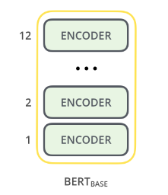
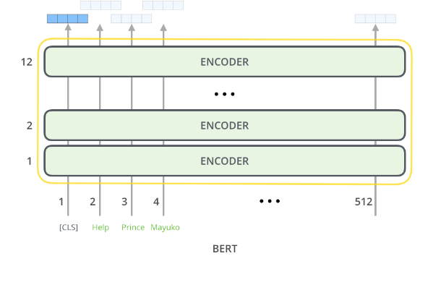
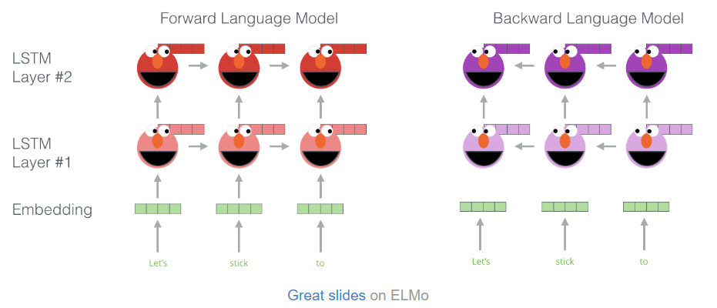
DIAGRAMS FOR BERT AND LSTM
BERT BASE
MODEL OUTPUT
ELMO (LSTM)

Slide 11
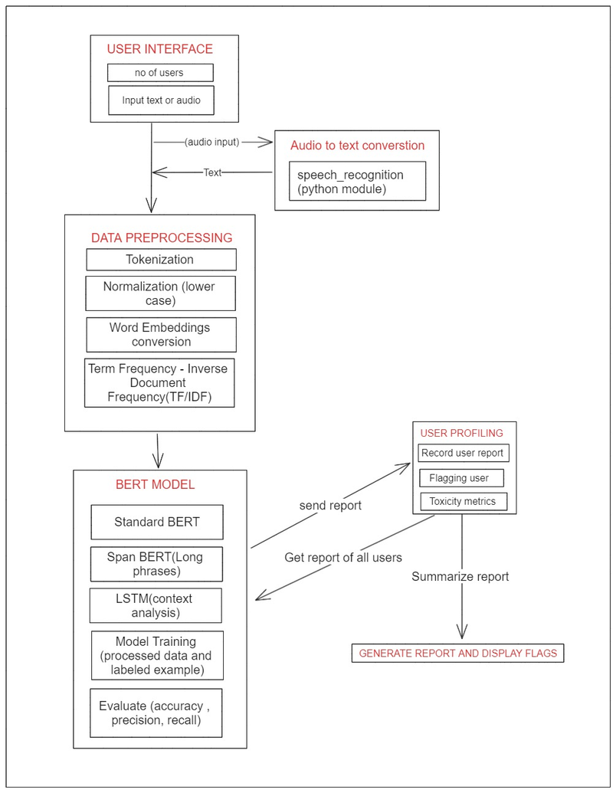
High Level System Design

Slide 12
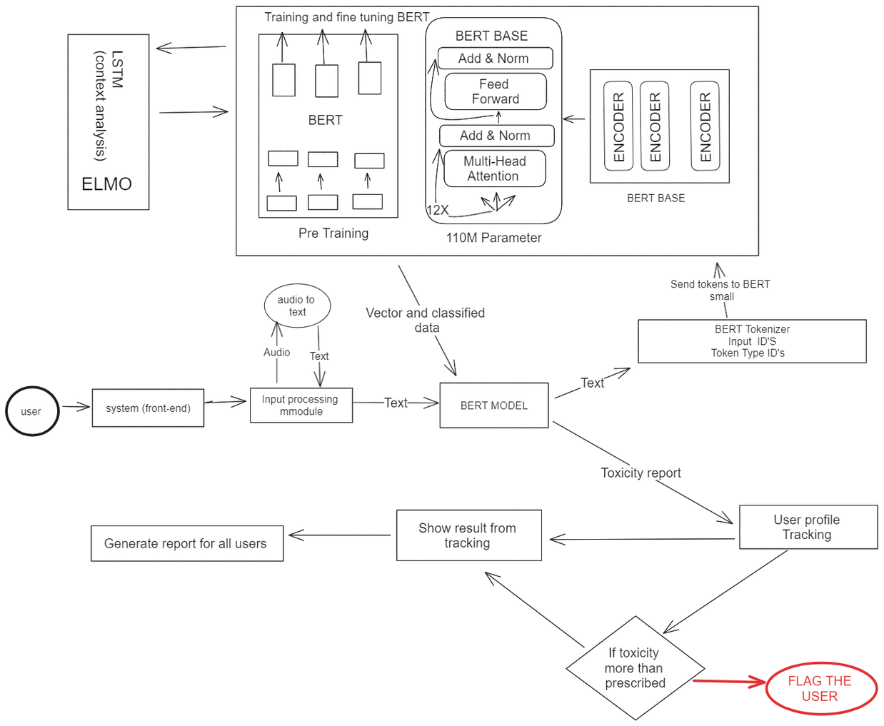
12 layers
Architecture

Slide 13
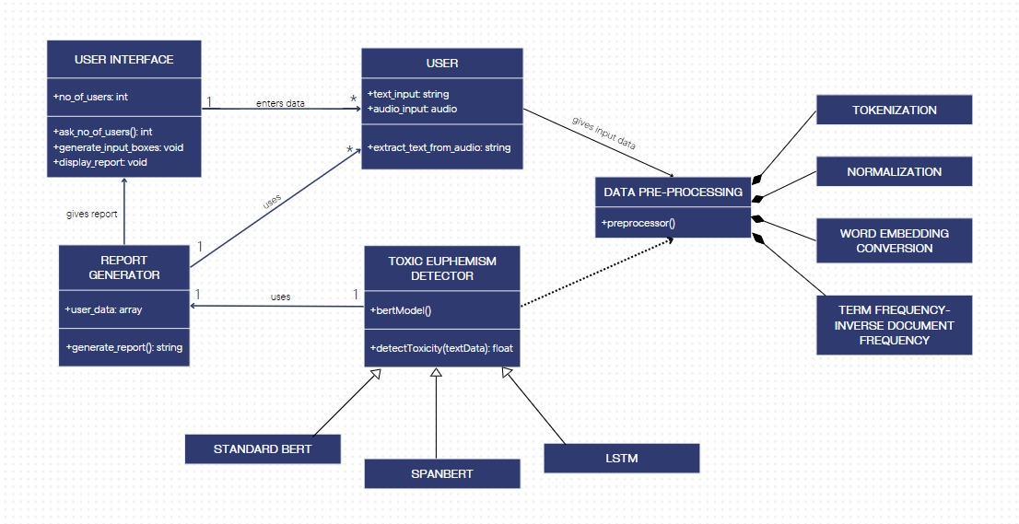
Design Description
Master class diagram

Slide 14
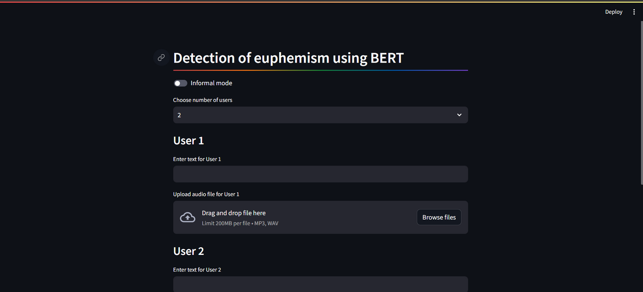
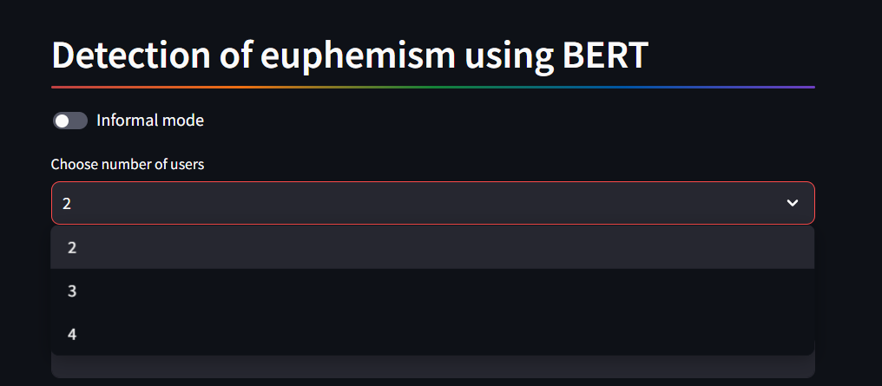
Design Description
User Interface
Main page
Selecting number of users

Slide 15
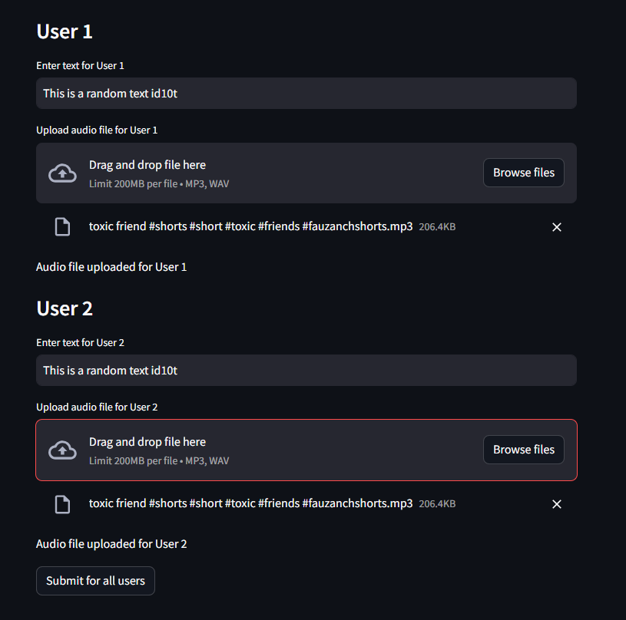

Design Description
User Interface
User View
Test Report

Slide 16
Technologies used
In our research paper , we plan to utilize BERT model for its exceptional performance in analyzing natural language text and detecting euphemisms in toxic language.
We plan to use python based frameworks and libraries, including PyTorch, scikit-learn, and Hugging face Transformers for their robustness, flexibility, and compatibility. These technologies will enable efficient model training, evaluation, and deployment processes.
The user interface will be developed using Streamlit, a Python library that will be utilized to create an intuitive and interactive interface, allowing users to input text and receive toxicity classification results seamlessly.

Slide 17
Project Progress
Exploration regarding various problem. statements.
Deciding of final problem statement.
Performed Feasibility Study.
Improvement and understanding of problem statement.
Started Literature Survey.
Deciding on architecture of the project and specifics of the model used

Slide 18
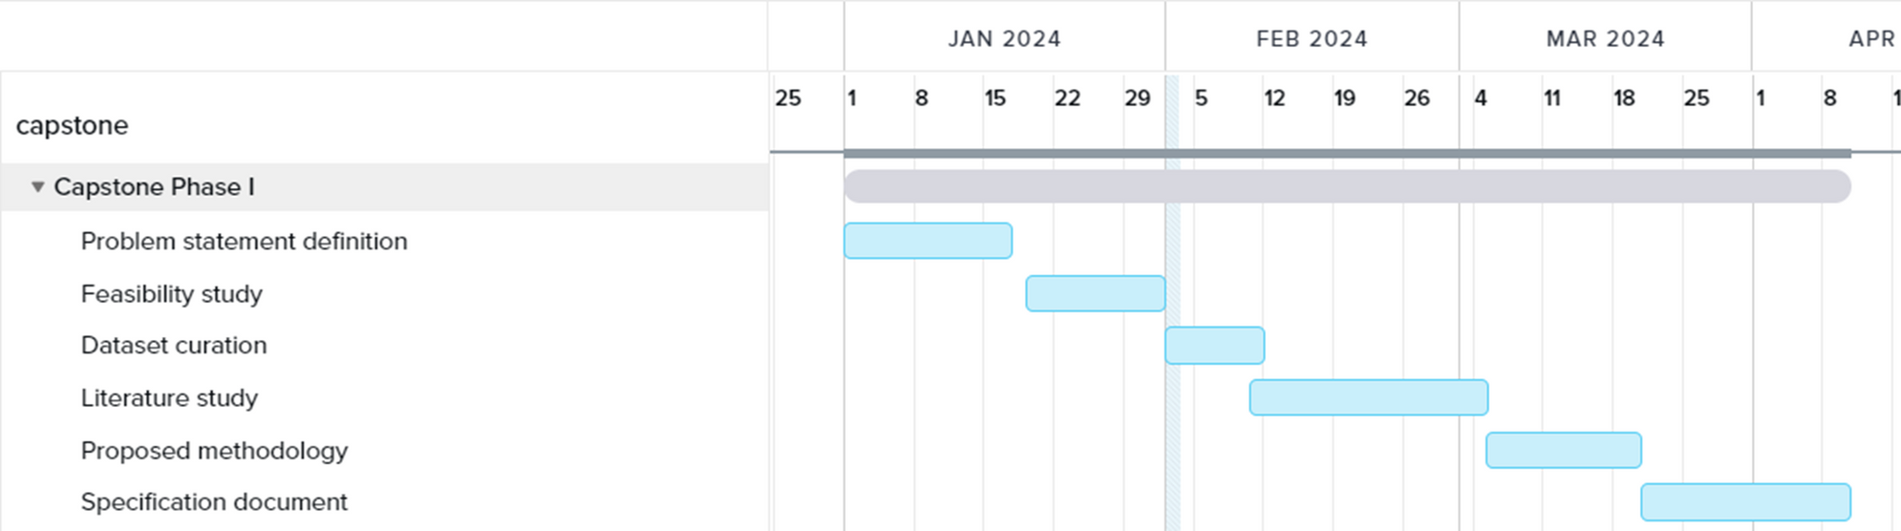
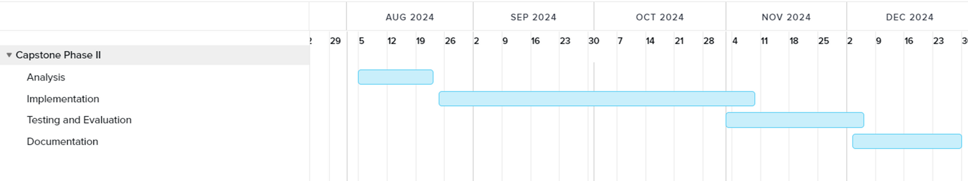
Capstone (Phase-I & Phase-II) Project Timeline

Slide 19
References
[1] Zhu, Wanzheng, and Suma Bhat. "Euphemistic phrase detection by masked language model." arXiv preprint arXiv:2109.04666 (2021).
[2] Kurita, Keita, Anna Belova, and Antonios Anastasopoulos. "Towards robust toxic content classification." arXiv preprint arXiv:1912.06872 (2019).
[3] Devi, Maibam Debina, and Navanath Saharia. "Identification of domain-specific euphemistic tweets using clustering." International Journal of Information Technology 16.1 (2024): 21-31.
[4] Aji, Fazjar Sekti, and Ade Iriani. "Toxicity and Sentiment Analysis About Digital Bounty on Social Media." 2023 12th International Conference on Awareness Science and Technology (iCAST). IEEE, 2023.

Slide 20
Conclusion
In conclusion, we have explored the methodologies and technologies aimed at detecting and managing online toxicity, an important concern in ensuring healthy digital environments.
Our proposed approach integrates advanced technologies like Large Language Models and machine learning with behavioral analysis methodologies to construct a responsive toxicity detection system.
With the foundational architecture outlined, inclusive of real-time monitoring and intervention capabilities, we are positioned to meet the urgent demand for proactive measures against toxic online behavior.
Moving forward, we will focus on detailed system implementation, addressing inherent challenges, and validating the system's efficacy in promoting safer and more constructive online interactions.

Slide 21
THANK YOU

